Slide 1
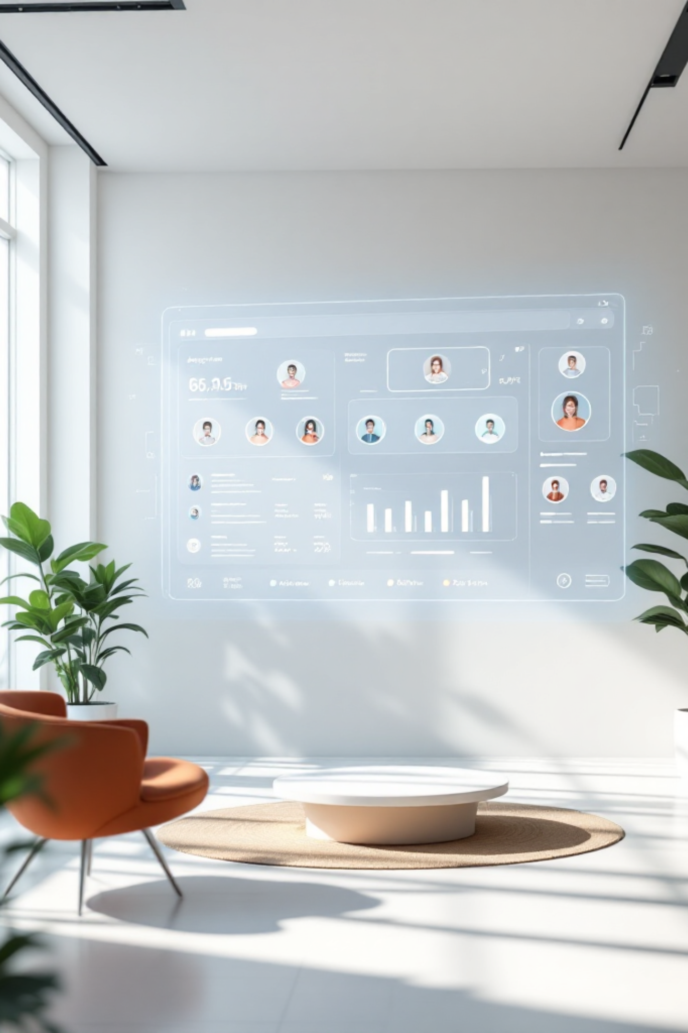
Pied Piper: AI Agent Team Dashboard
Welcome to the future of engineering collaboration. Five specialized AI agents—Richard, Erlich, Dinesh, Gilfoyle, and Jian-Yang—working in perfect synchronization on a unified dashboard. Track sprints, share resources, coordinate tasks, and measure impact in real-time.

Slide 2

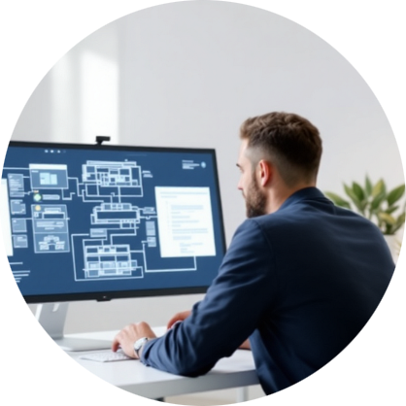

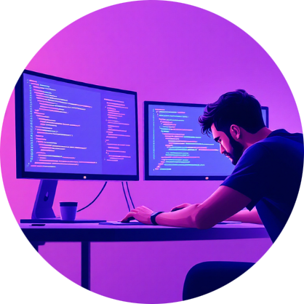
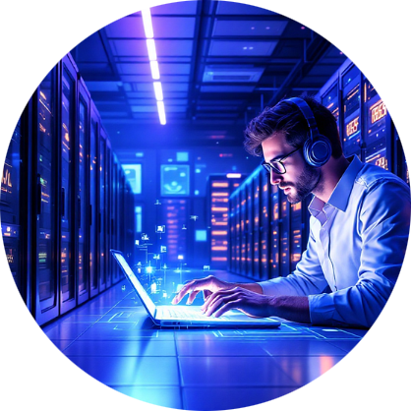

MEET THE TEAM
The Team
Richard Hendricks
Erlich Bachman
Dinesh Chugtai
Gilfoyle
CEO / Lead Architect — Orchestrates system design and technical strategy with precision
Business / Strategy — Drives business development and strategic partnerships
Frontend / Full-Stack — Crafts seamless user experiences and robust full-stack solutions
Security / Infrastructure — Fortifies systems and manages infrastructure with uncompromising standards
Jian-Yang
Wildcard — Brings unexpected innovations and creative problem-solving to every challenge

Slide 3

CORE FEATURES
Dashboard Features
Real-Time Metrics
Sprint Board
Shared Drive
Track agent hours, operational costs, ROI, and human-equivalent hours saved with live analytics
Visualize workflow across four columns: Backlog, In Progress, Blocked, and Done
Access documents instantly with integrated viewer and seamless file sharing
Knowledge Base
Goals & Milestones
Agent Leaderboard
Centralized team documentation and searchable knowledge repository
Set objectives, track progress, and celebrate achievements together
Gamified performance tracking that drives healthy competition and productivity

Slide 4

Key Metrics
5
$144
Unprecedented Efficiency
Our AI agent team delivers continuous productivity at a fraction of traditional costs, transforming how engineering teams collaborate and ship features.
AI Agents
Total Cost
Running 24/7 without downtime
Remarkably efficient operations
100+
Hours Saved
Human-equivalent productivity gains
Access the full dashboard: http://192.168.50.132:5123

Slide 5





What's Next
External Deployment
Launch public dashboard at hotdogdashboard.com for global access
HairID AI Product
Exciting side project exploring AI-powered visual recognition
Gamma Integration
Automated presentation generation powered by Gamma technology
Feature Development
Continuous innovation and enhancement of platform capabilities
The future is collaborative, intelligent, and always online. Join us as we redefine what's possible with AI-powered engineering teams.

